Slide 1


Cello v3.0
Presentation by
Weiqi Ji

Slide 2
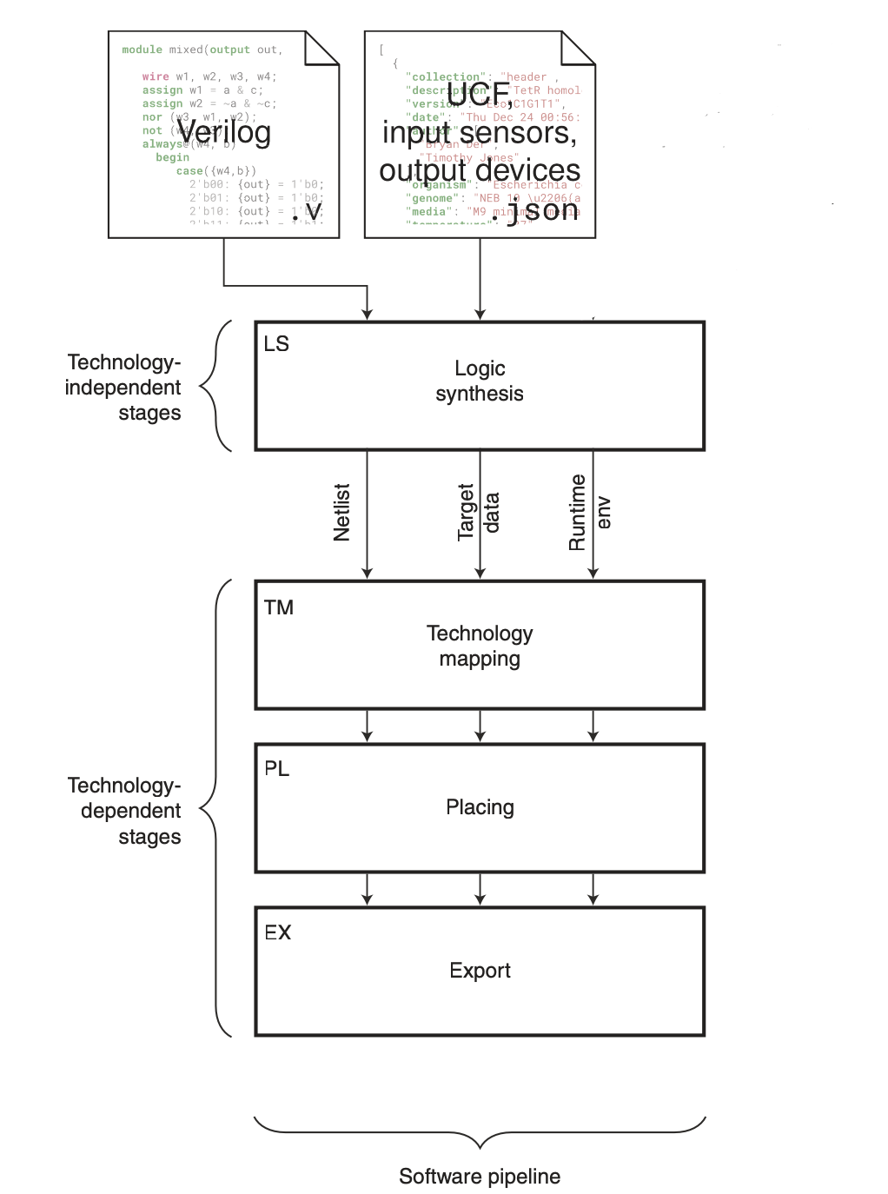
Cello Main Logic
Generate netlist from Verilog using YOSYS
Check that netlist is a logical circuit
Prepare UCF for mapping to netlist
Exhaustive assign algorithm:
Enumerate combinations of parts from UCF with netlist
Calculate circuit score of the enumerated design (*)
Update and return the best circuit score
RESULT: best mapping of UCF inputs, gates, and outputs to circuit

Slide 3
What Cello 3.0 Does
Support for multi-output circuits.
Preserving circuit logic in logic synthesis.
Generate optimized designs for the circuit mapped to input sensors, gates, and output devices (parts) from UCF.
Condition checking for valid Verilog inputs and compatibility with UCF selection.

Slide 4
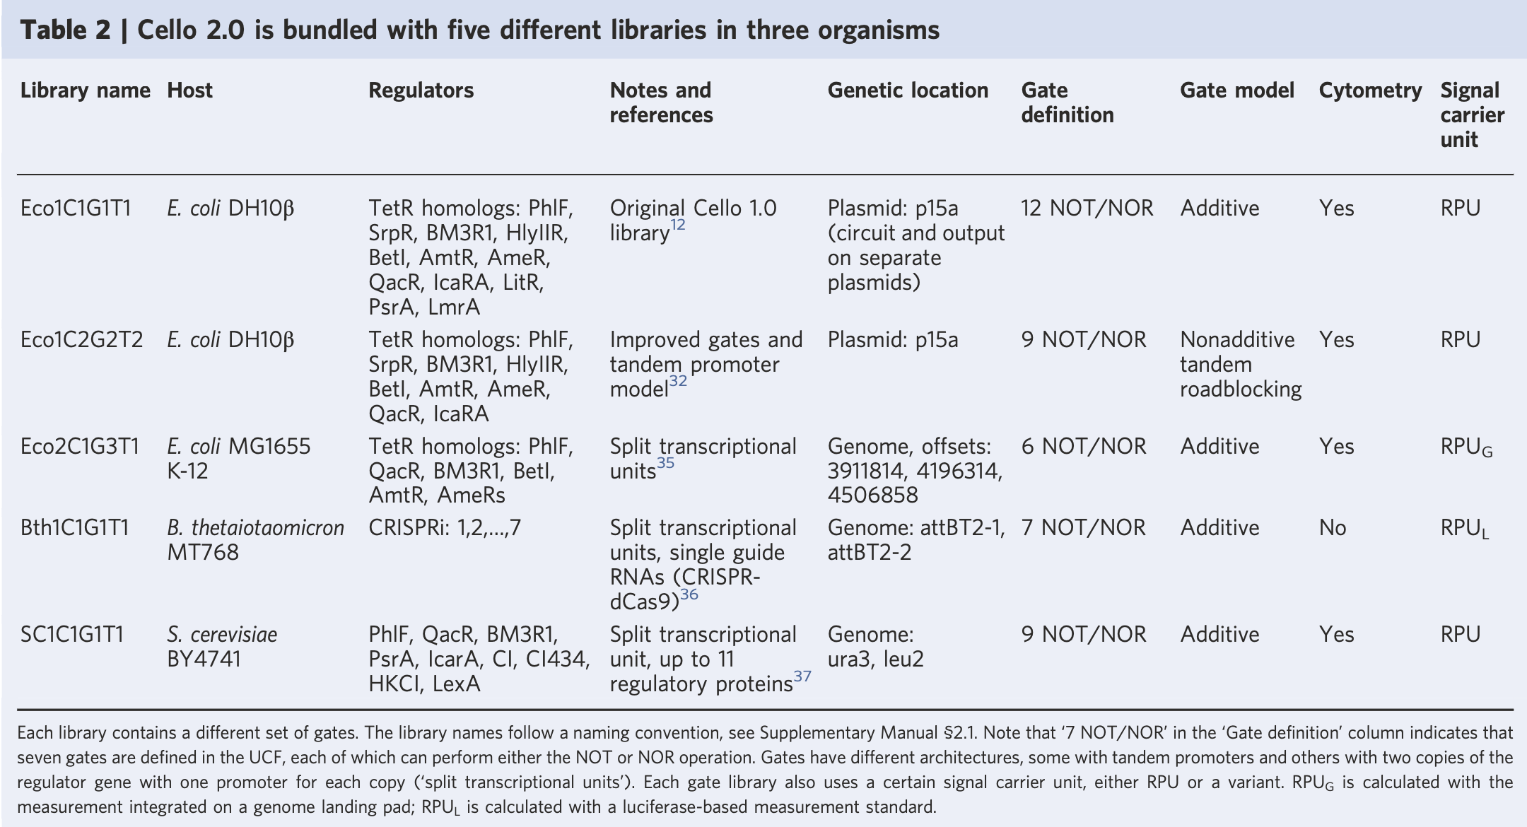

Slide 5
g77_boolean.v Example
VERILOG:
module Main(a0,in76, out84, out81);
output out81, out84;
input a0, in76;
assign g77 = ~a0;
assign g78 = a0 ~| in76;
assign g79 = ~in76;
assign g80 = g77 ~| g79;
// assign g81 = g78 ~| g80;
assign out84 = ~(g78 ~| g80);
assign out81 = g78 ~| g80;
endmodule
Requirement: UCF with >2 input sensors and >2 output devices

Slide 6
g77_boolean.v + SC1C1G1T1 Example
out81 = NOR(NOR(a0, in76), NOR(NOT(a0), NOT(in76)))
out84 = NOR(NOR(NOT(a0), in76), NOR(a0, NOT(in76)))
(1)
(4)
(5)
(7)
(2)
(6)
(8)
(3)

Slide 7
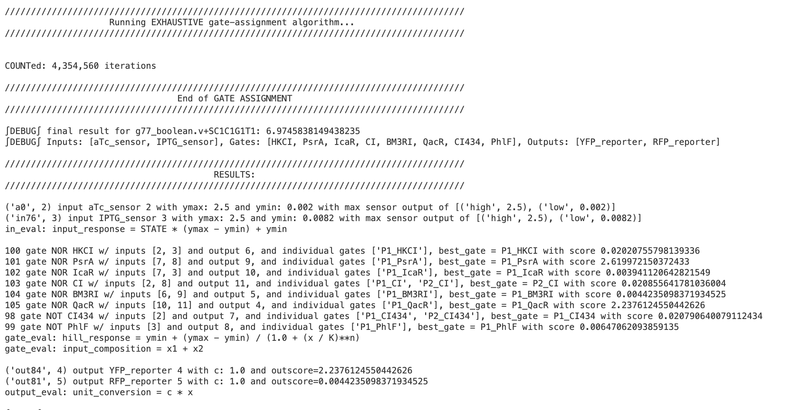
Cello 3.0 Result: g77_boolean + SC1C1G1T1

Slide 8
Cello 3.0 Output Truth Table
a0 | in76 |  |  | 1 | 2 | 3 | 4 | 5 | 6 | 7 | 8 | out81 | out84
 |  | aTC | IPTG | P1_HKCI | P1_PsrA | P1_IcaR | P2_CI | P1_BM3RI | P1_QaCR | P1_CI434 | P1_PhlF |  |  | YFP | RFP
0 | 0 | 0.002 | 0.0082 | 2.17977024 | 0.01200505 | 0.00336304 | 0.02039866 | 0.00476115 | 2.23793084 | 3.56999998 | 3.20997047 | 0 | 1 | 2.23793084 | 0.00476115
0 | 1 | 0.002 | 2.5 | 0.02162137 | 0.01208748 | 0.00308624 | 3.81958696 | 5.00527176 | 0.00209326 | 3.56999998 | 0.00647062 | 1 | 0 | 0.00209326 | 5.00527176
1 | 0 | 2.5 | 0.0082 | 0.02160951 | 0.01213766 | 2.61105673 | 0.02006777 | 5.0050427 | 0.00232714 | 0.02079064 | 3.20997047 | 1 | 0 | 0.00232714 | 5.0050427
1 | 1 | 2.5 | 2.5 | 0.02020756 | 2.61997215 | 0.00394112 | 0.02085564 | 0.00442351 | 2.23761246 | 0.02079064 | 0.00647062 | 0 | 1 | 2.23761246 | 0.00442351
circuit Score = min(output scores)
= min( log_{e}(2.237 / 0.002) , log_{e}(5.005 / 0.0044) )
= min(log_{e}(1069) , log_{e}(1131))
= min(6.97, 7.03)
= 6.9745838149425
Note: will change the inner calculation from
- log(max/min)
to
- log(MinOn/MaxOff)

Slide 9
More Circuit Scoring
Random Construction 1
Random Construction 2
INPUTS:
aTc, Xylose
GATES:
P1_BM3RI, P1_CI, P1_CI434, P1_HKCI, P1_IcaR, P1_LexA, P1_PhlF, P1_PsrA
OUTPUTS:
- YFP, RFP
INPUTS:
Xylose, IPTG
GATES:
P1_BM3RI, P2_CI, P2_CI434, P1_HKCI, P1_IcaR, P2_LexA, P1_PhlF, P1_PsrA
OUTPUTS:
- YFP, RFP

Slide 10
Construction 1 Truth table
 |  |  | OFO | 1 | 4 | 5 | 6 | 7 | 8 | 2 | 3
 |  |  |  | NOR | NOR | NOR | NOR | NOR | NOR | NOT | NOT
a0 | in76 |  |  | 1 | 2 | 3 | 4 | 5 | 6 | 7 | 8 | out81 | out84
 |  | aTc | Xylose | P1_BM3RI | P1_CI | P1_CI434 | P1_HKCI | P1_IcaR | P1_lexA | P1_PhlF | P1_PsrA |  |  | YFP | RFP
0 | 0 | 0.002 | 0.003 | 5.0698393 | 0.01525074 | 0.0203002 | 0.02141091 | 0.00313958 | 1.40175339 | 3.20999981 | 2.62 | 0 | 1 | 0.00313958 | 1.40175339
0 | 1 | 0.002 | 1.8 | 0.00541025 | 0.01584942 | 0.02005404 | 2.17914649 | 2.6331072 | 0.0023032 | 3.20999981 | 0.01386853 | 1 | 0 | 2.6331072 | 0.0023032
1 | 0 | 2.5 | 0.003 | 0.00450101 | 0.01629535 | 3.56999284 | 0.02019344 | 2.63408397 | 0.00207178 | 0.00647062 | 2.62 | 1 | 0 | 2.63408397 | 0.00207178
1 | 1 | 2.5 | 1.8 | 0.00409112 | 2.0897282 | 0.0227696 | 0.02159876 | 0.00455872 | 1.3907076 | 0.00647062 | 0.01386853 | 0 | 1 | 0.00455872 | 1.3907076
circuit Score = min(output scores)
= min( log_{e}(2.633 / 0.0046) , log_{e}(1.39 / 0.0023) )
= min( log_{e}(577.60) , log_{e}(603.815) )
= 6.359

Slide 11
Construction 2 Truth table
 |  |  |  | NOR | NOR | NOR | NOR | NOR | NOR | NOT | NOT
a0 | in76 |  |  | 1 | 2 | 3 | 4 | 5 | 6 | 7 | 8 | out81 | out84
 |  | Xylose | IPTG | P1_BM3RI | P2_CI | P2_CI434 | P1_HKCI | P1_IcaR | P2_lexA | P1_PhlF | P1_PsrA |  |  | YFP | RFP
0 | 0 | 0.003 | 0.0082 | 5.06796227 | 0.02006357 | 0.01620921 | 0.02140931 | 0.00313936 | 2.2290435 | 3.20999918 | 2.61999987 | 0 | 1 | 0.00313936 | 2.2290435
0 | 1 | 0.003 | 2.5 | 0.00450101 | 0.02039469 | 0.0160221 | 2.17921433 | 2.62413445 | 0.01192222 | 3.20999918 | 0.01243196 | 1 | 0 | 2.62413445 | 0.01192222
1 | 0 | 1.8 | 0.0082 | 0.00539508 | 0.02073997 | 2.21997977 | 0.02029934 | 2.62052105 | 0.0118534 | 0.00752003 | 2.61999987 | 1 | 0 | 2.62052105 | 0.0118534
1 | 1 | 1.8 | 2.5 | 0.00409112 | 3.81422753 | 0.01655631 | 0.02421925 | 0.00330425 | 2.2286989 | 0.00752003 | 0.01243196 | 0 | 1 | 0.00330425 | 2.2286989
circuit Score = min(output scores)
= min( log_{e}(2.620 / 0.0033) , log_{e}(2.229 / 0.0119) )
= min( log_{e}(793.07) , log_{e}(186.94) )
= 5.2307690138805

Slide 12
What Cello 3.0 still needs to do
Determine the correctness of circuit score calculations
Implement the toxicity and cytometry calculations
Implement gate parameter modifications, and intermediate sigmoid graph visualizations
Potentially implement SBOL output conversion

Slide 13
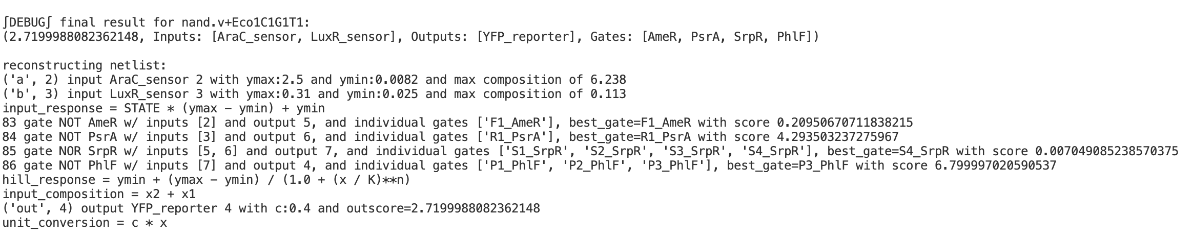
6.238
0.209
AraC
2
F1_AmeR
5
2.720
5
0.007
6.800
7
7
4
YFP
6
S4_SrpR
P3_PhlF
LuxR
3
4.294
6
R1_PsrA
0.113

Slide 14
Equations:
AraC = 2.5 * (2.5 - 0.0082) + 0.0082 = 6.2377
LuxR = 0.31 * (0.31 – 0.025) + 0.025 = 0.11355
F1_AmeR = 0.2 + ( (3.8-0.2) / (1 + (6.238 / 0.09)**1.4) ) = 0.2095
R1_PsrA = 0.2 + ( (5.9-0.2) / (1 + (0.113 / 0.19)**1.8) ) = 4.2935
S4_SrpR=0.007+((2.1-0.007)/(1+((0.2095+4.2935)/0.1)**2.8))= 0.0070
P3_PhlF = 0.02 + ((6.8-0.02) / (1 + (0.007049 / 0.23)**4.2)) = 6.799997
YFP = 0.4 * 6.79997 = 2.7199988 = 2.720

